Slide 1

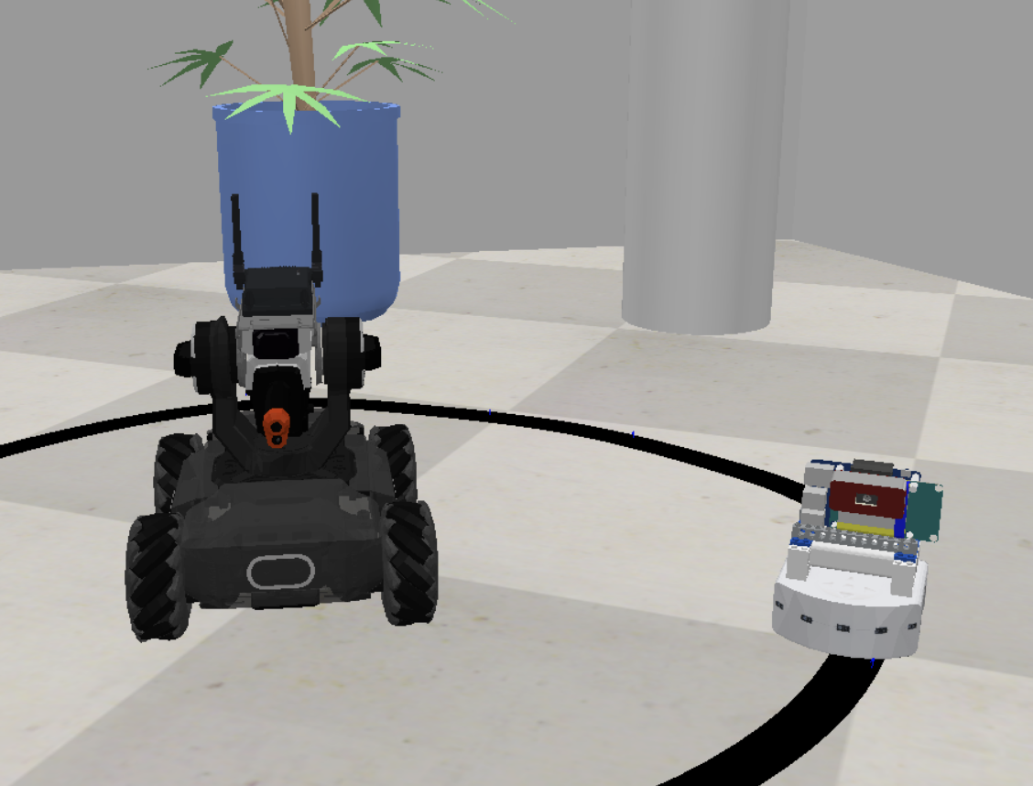
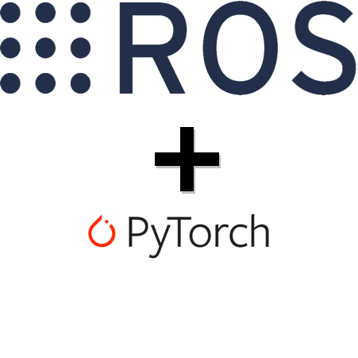
Follow
That
Thymio
Robotics Project
Alessandro De Grandi & Filippo Casari

Slide 2
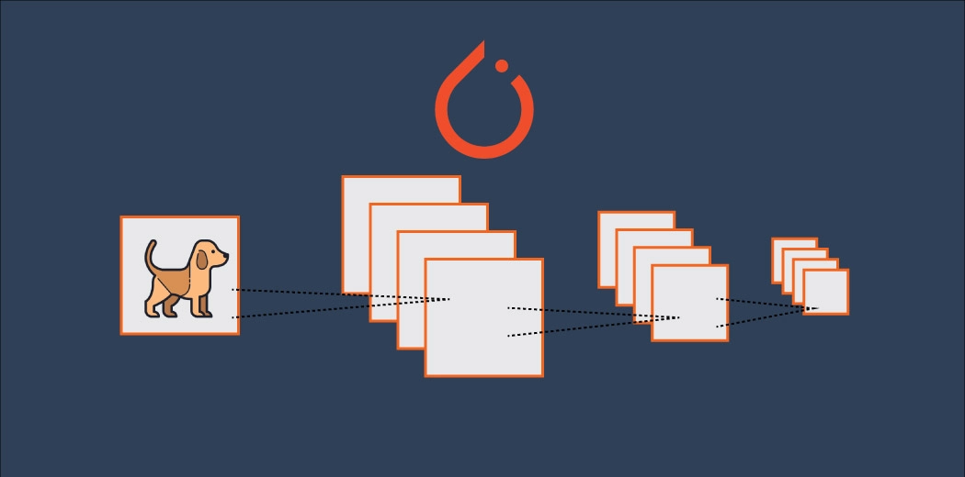
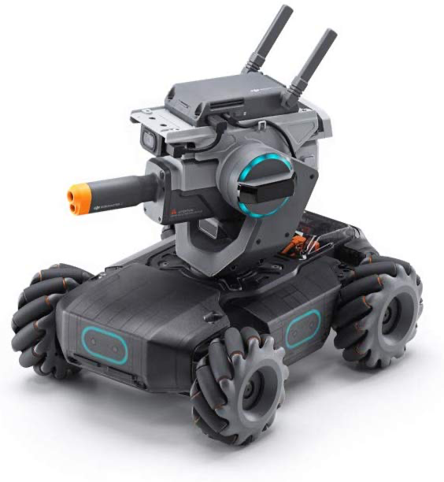

OBJECTIVES
First Step
Second step
Third Step
Fourth step
Thymio follows the line
Robomaster follows Thymio
Profit
Build a dataset
&
Train the model

Slide 3
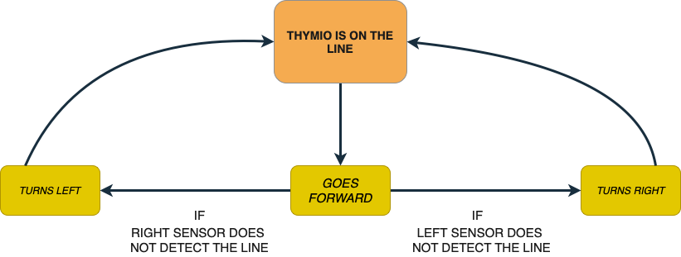
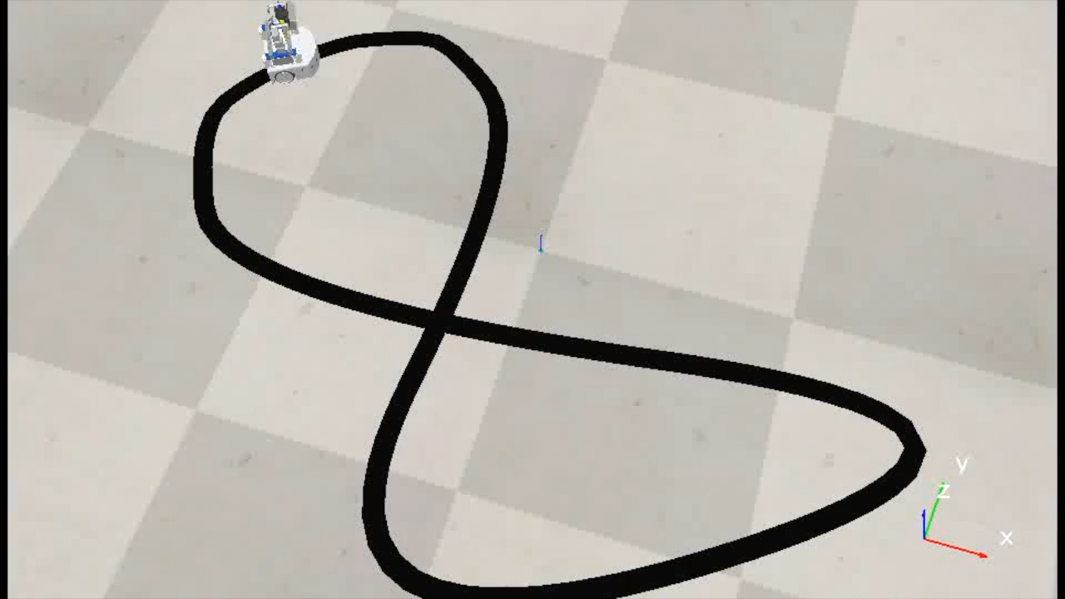
THYMIO FOLLOWS THE LINE

Slide 4
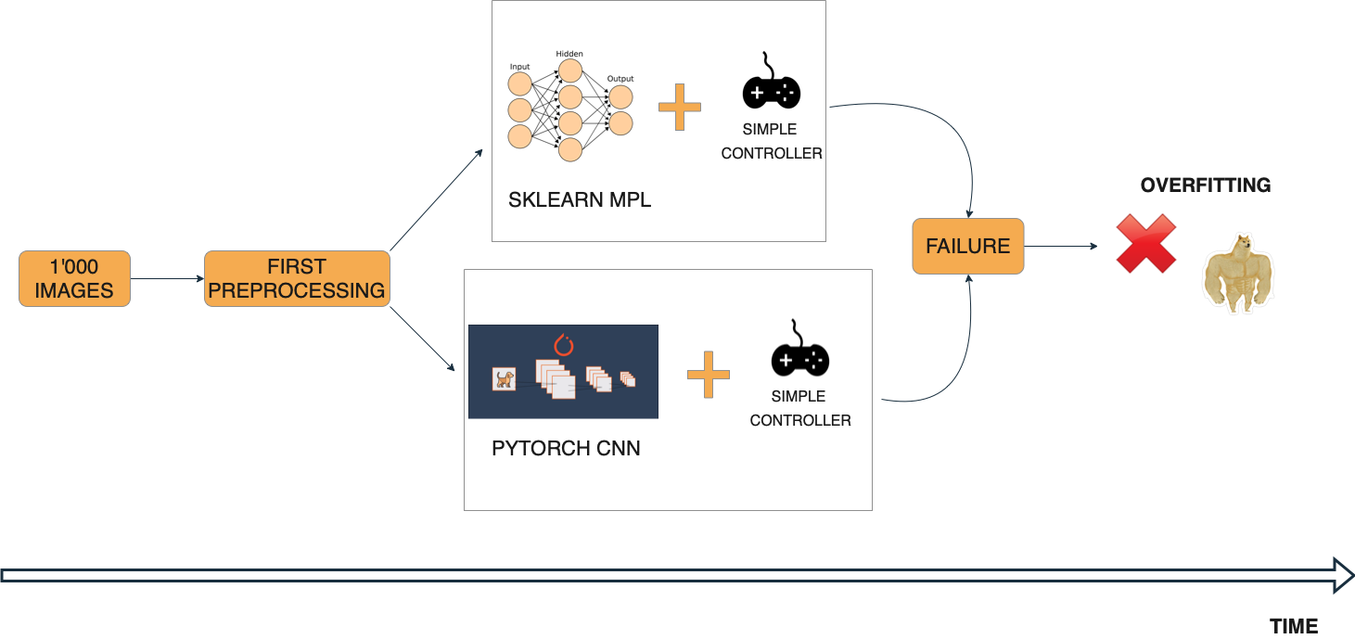
FIRST APPROACH: LEFT AND RIGHT CLASSIFIERS

Slide 5
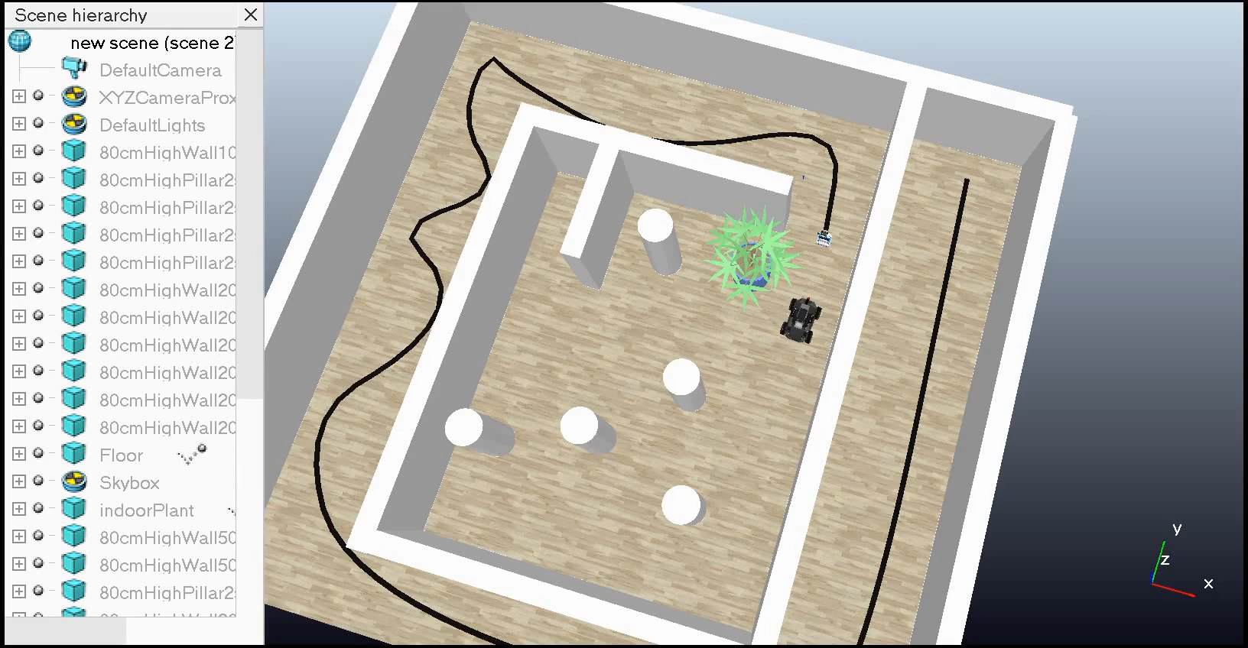
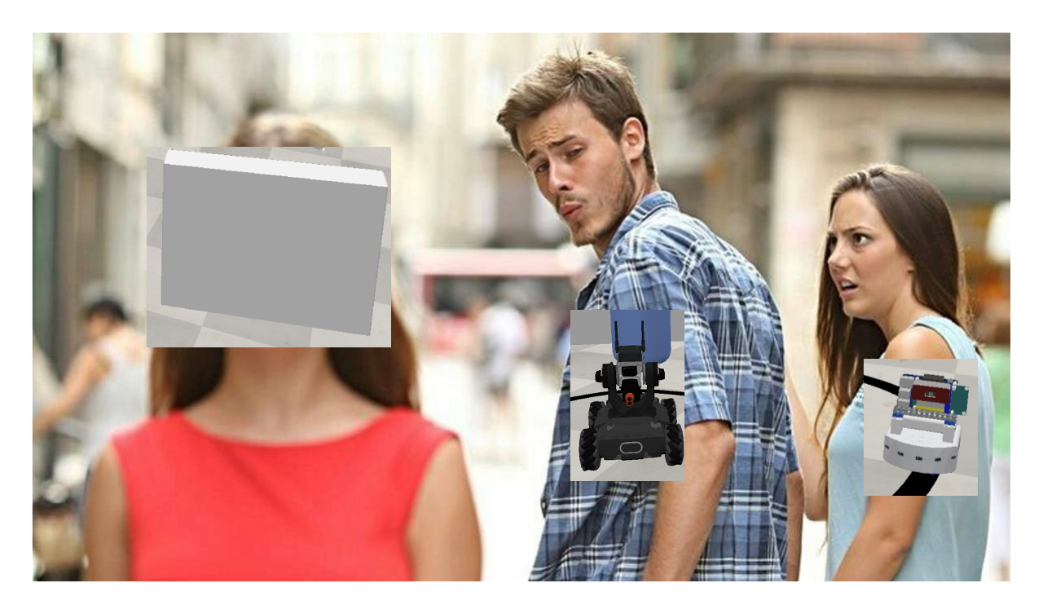
FAILURE USING MPL MODEL FROM SKLEARN
The model follows the thymio but:
The model probably overfits the scene
Sometimes the RoboMaster hits the wall when it turns

Slide 6
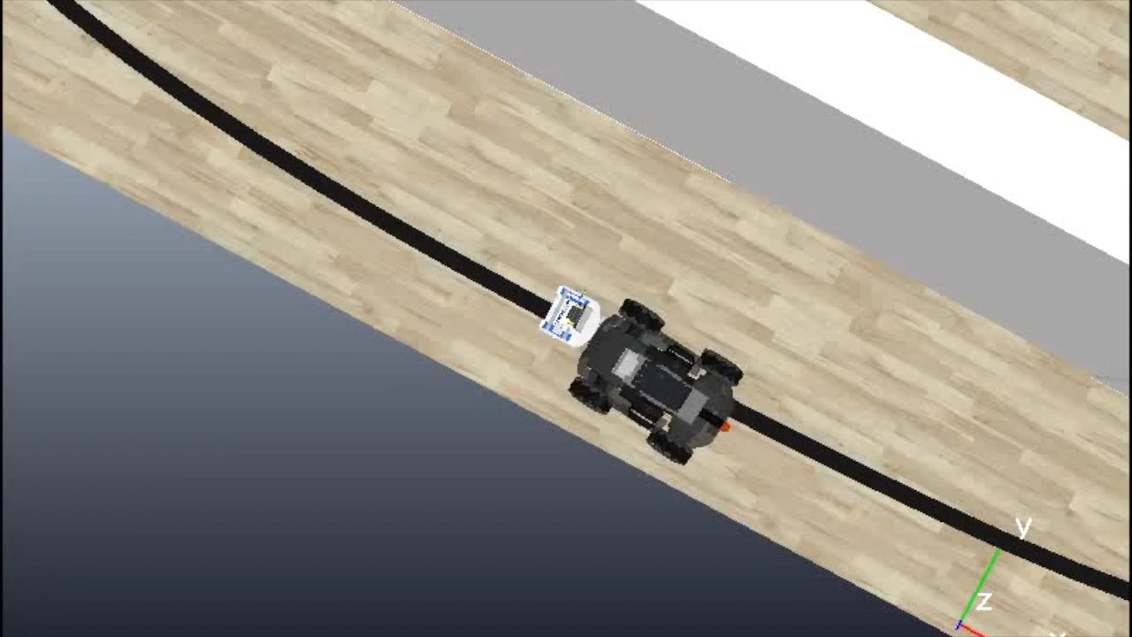
FAILURE USING CNN MODEL
OVERFITTING THE SCENE
SURPASSING AND COLLIDING WITH THYMIO

Slide 7
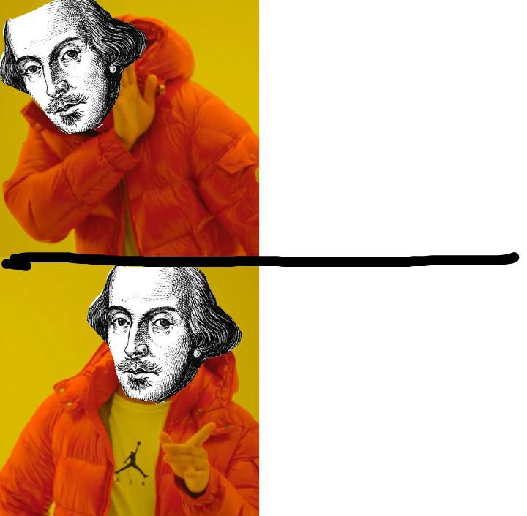
CHANGE APPROACH
LEFT or RIGHT
THYMIO or NOT THYMIO,
this is the question

Slide 8
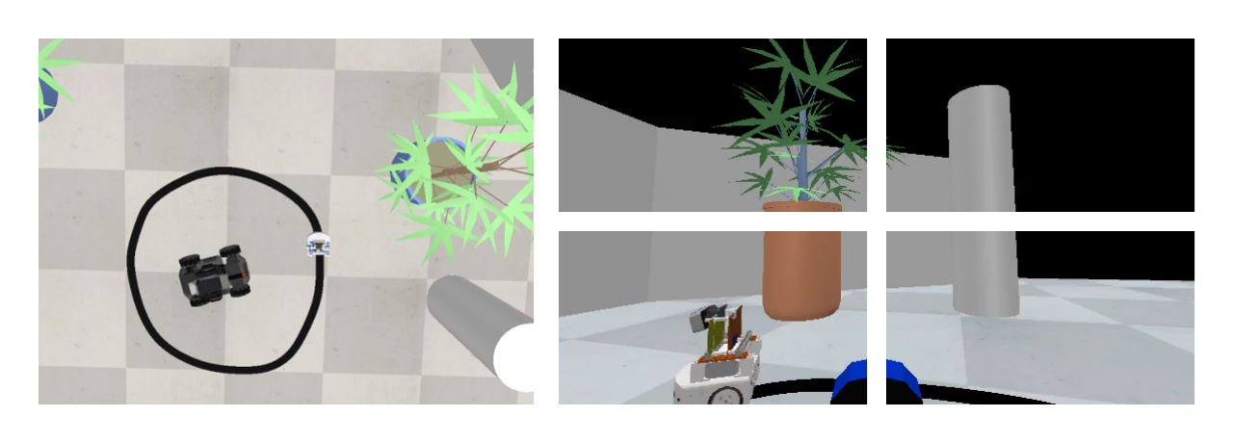
IMPROVED APPROACH
AUTOMATIC COLLECTION
THYMIO OR NOT THYMIO..

Slide 9
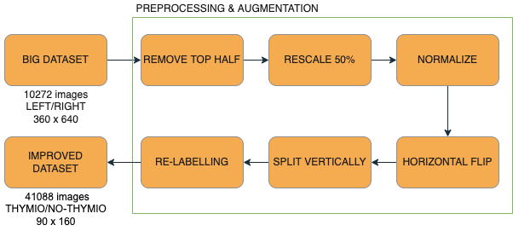
PREPROCESSING and AUGMENTATION

Slide 10
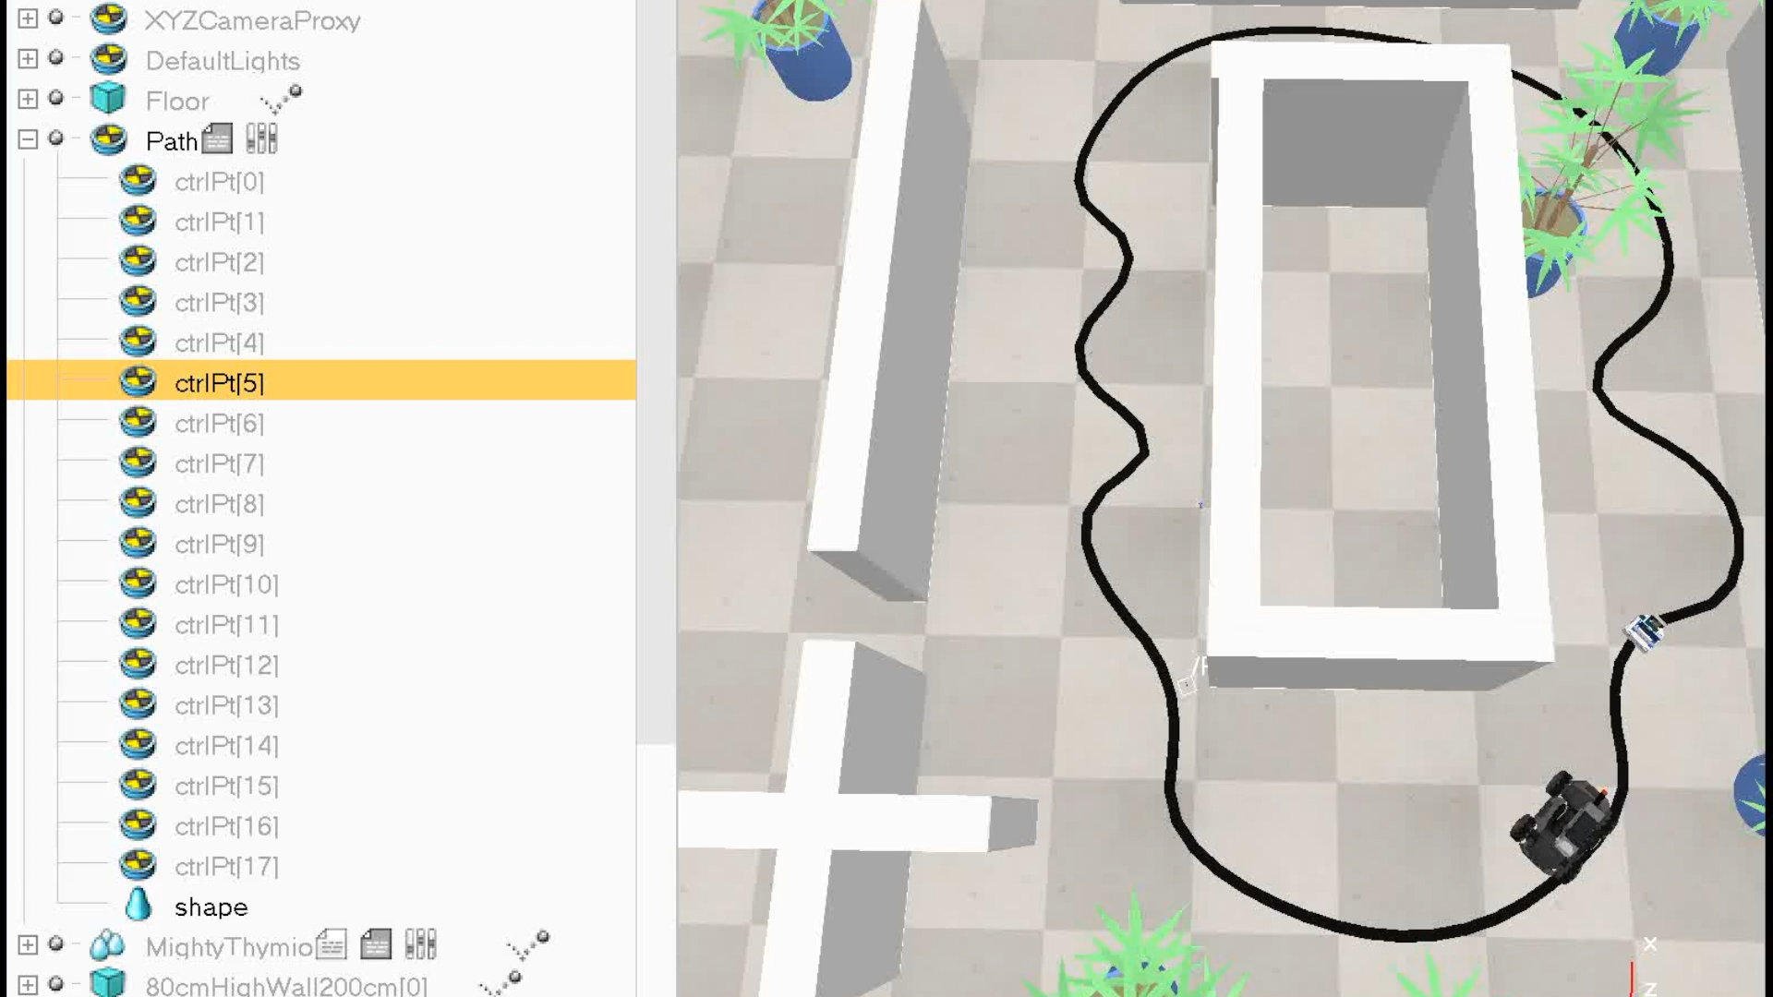
TEST
Good generalized model
No proximity sensors cause collisions
Fails when Thymio is out of sight

Slide 11
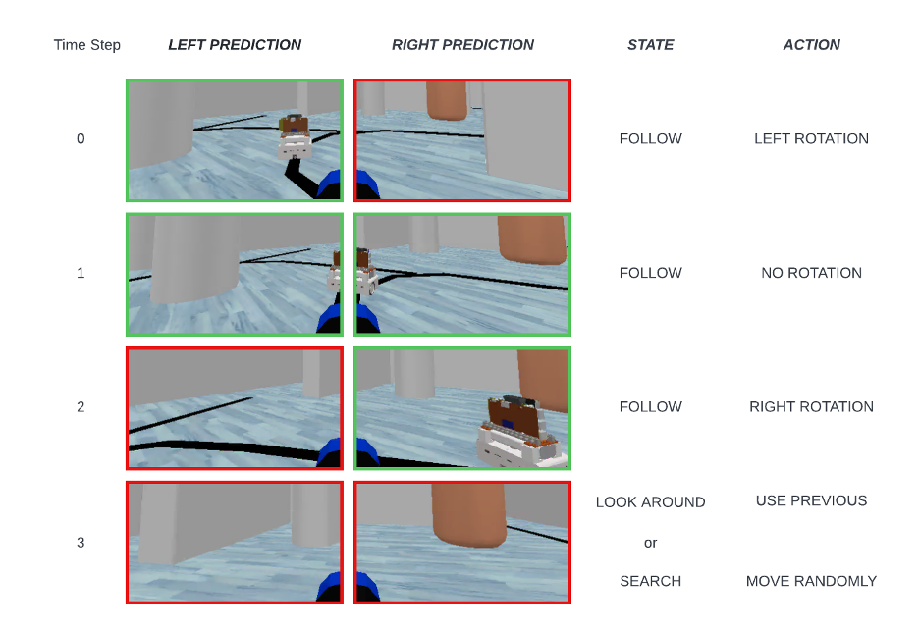
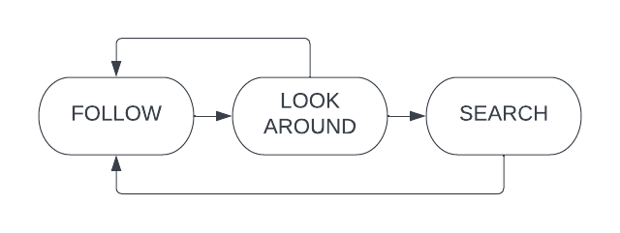
IMPROVED ROBOMASTER CONTROLLER

Slide 12
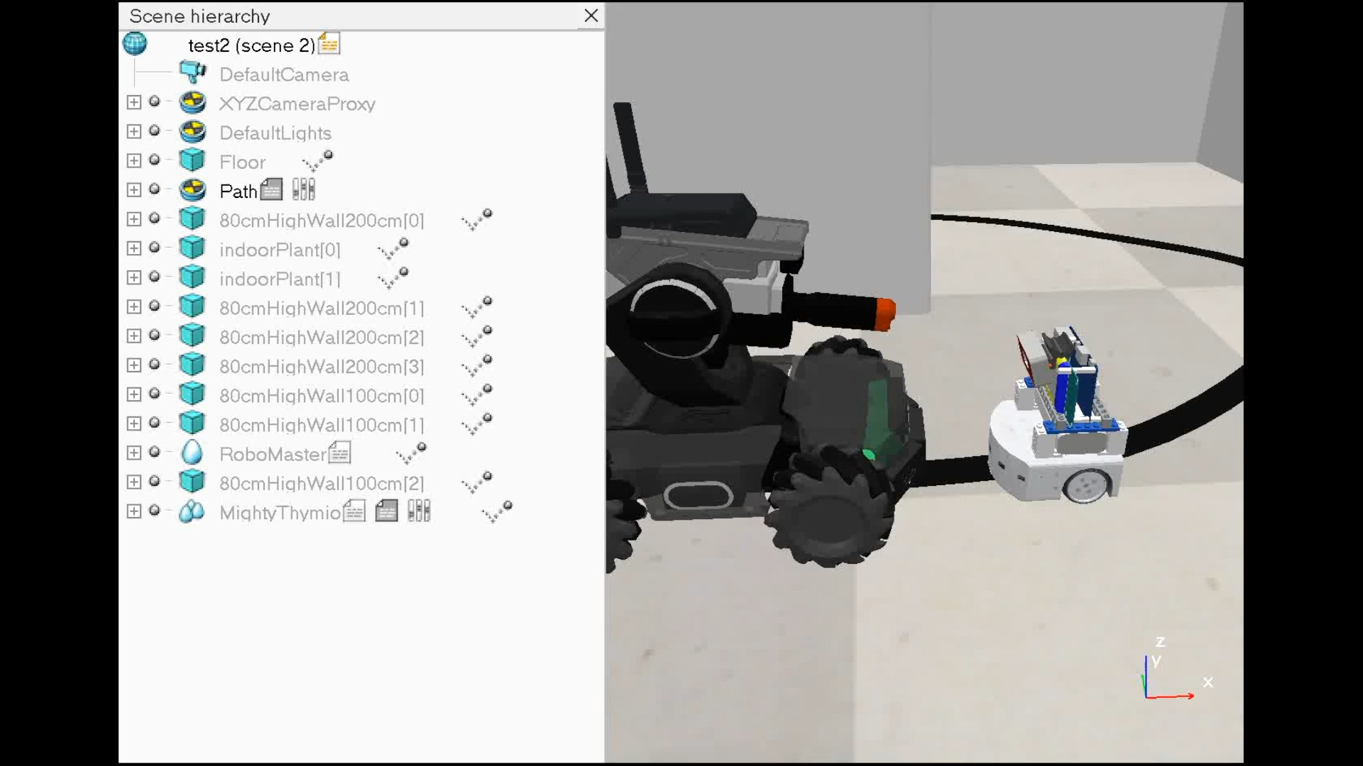
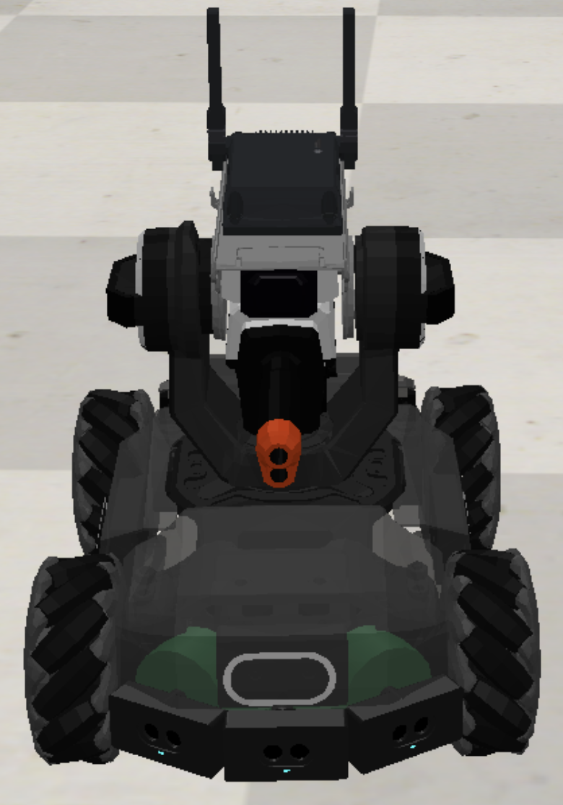
PROXIMITY SENSORS
3 forward looking ToF sensors

Slide 13

FINAL RESULTS

